Slide 1
Real-time epidemic modelling of SARS-CoV-2 from wastewater data
15th June 2022

Slide 2
Overview
Mathematical Modelling
Package to estimate active case number
COVID19WasterWater
Packages using reported number of new cases to estimate R_{t}
Epyestim
EpiNow2
Machine Learning
Use actual R_{t} for training

Slide 3
Tables
Name | Description
df | Raw data
rnalevel | Subset to study period; Removed rows with ’(empty)’ values
gene_ts | Total RNA level from all sites grouped by day
gene_weekly | RNA levels grouped by week and sitecode
ALLA | Weekly RNA levels from site ALLA

Slide 4
Specifications
Study period: 6/7/2020 (Monday) – 28/3/2021 (Sunday)
Records with empty ‘population’ are removed from analysis
Missing population should be imputed from appropriate source e.g. ONS
Site: ALLA
population: 62058
weeks: 5 - 38 (7/8/2020 – 26/3/2021)

Slide 5
Mathematical Modelling
COVID19WastewaterModel (R package)
Active case number to new case number
Epyestim (available on R and Python)

Slide 6
COVID19WasteWatermodel
https://github.com/scwatson812/COVID19WastewaterModel
SEIR model simulation of change of RNA level over time
MCMC simulation:
Change of RNA level over time
Number of active cases from RNA level

Slide 7
No. | Variable | Definition | Value input
1 | Sim | A positive integer number of simulations to run. | 30
2 | Tm | An positive integer number of days over which to run the simulation. | 90
3 | beta.s | A numeric transmission rate for the SEIR model. See the documentation for SEIR.model. | 1
4 | gamma.e | A numeric inverse of incubation time. Suggested value: 0.2. See the documentation for SEIR.model. | 0.2
5 | gamma.i | A numeric inverse of duration of infection. Suggested value 0.1. See the documentation for SEIR.model. | 0.1
6 | p | A numeric between 0 and 1 giving the proportion of the population initially infected. This proportion will be divided equally between the exposed and infectious states. | 0.005
7 | N | An integer for the population contributing to the sewershed. | 62500
8 | mu.V.max | A numeric mean of the normal distribution governing the maximum number of RNA copies shed by each individual. Should be on the log scale. Suggested value 7.6. See Viral.load.sim documentation for more details. | 7.6
9 | sd.V.max | A numeric standard deviation of the normal distribution governing the maximum number of RNA copies shed by each individual. Should be on the log scale. Suggested value 0.8. See Viral.load.sim documentation for more details. | 0.8

Slide 8
No. | Variable | Definition | Value input
10 | mu.V.20 | A numeric mean of the normal distribution governing the number of RNA copies shed by each individual 20 days after maximum shedding occurs. Should be on the log scale. Suggested value 3.5. See Viral.load.sim documentation for more details. | 3.5
11 | sd.V.20 | A numeric standard deviation of the normal distribution governing the number of RNA copies shed by each individual 20 days after maximum shedding occurs. Should be on the log scale. Suggested value 0.35. See Viral.load.sim documentation for more details. | 0.35
12 | T.V.max | A integer number of days from exposure to maximum viral shedding. Suggested value 5. See Viral.load.sim documentation for more details. | 5
13 | Ts | A numeric amount of time (in hours) that RNA is in the sewershed prior to reaching the location at which wastewater sampling takes place. | 4
14 | Temp | A numeric ground temperature (in degrees C) of the sewershed. | 18

Slide 9
No. | Variable | Definition | Value input
15 | mu.tau0 | A numeric mean for the normal distribution from which the half life (in hours) of the RNA is simulated. | 1
16 | sd.tau0 | A numeric standard deviation for the normal distribution from which the half life (in hours) of the RNA is simulated. Must be greater than 0. | 0.1
17 | mu.Q | A numeric mean of the normal distribution from which the RNA half life temperature conversion constant (degrees Celcius) is simulated. Suggested value 2.5. | 2.5
18 | sd.Q | A numeric standard deviation for the normal distribution from which the RNA half life temperature conversion constant (degrees Celcius) is simulated. Must be greater than 0. Suggested value 0.15. | 0.15
19 | G.mean | A numeric mean for the normal distribution from which the number of grams of feces each person contributes to the sewershed each day will be generated. | 128
20 | G.sd | A numeric standard deviation for the normal distribution from which the number of grams of feces each person contributes to the sewershed each day will be generated. Must be greater than 0. | 10

Slide 10
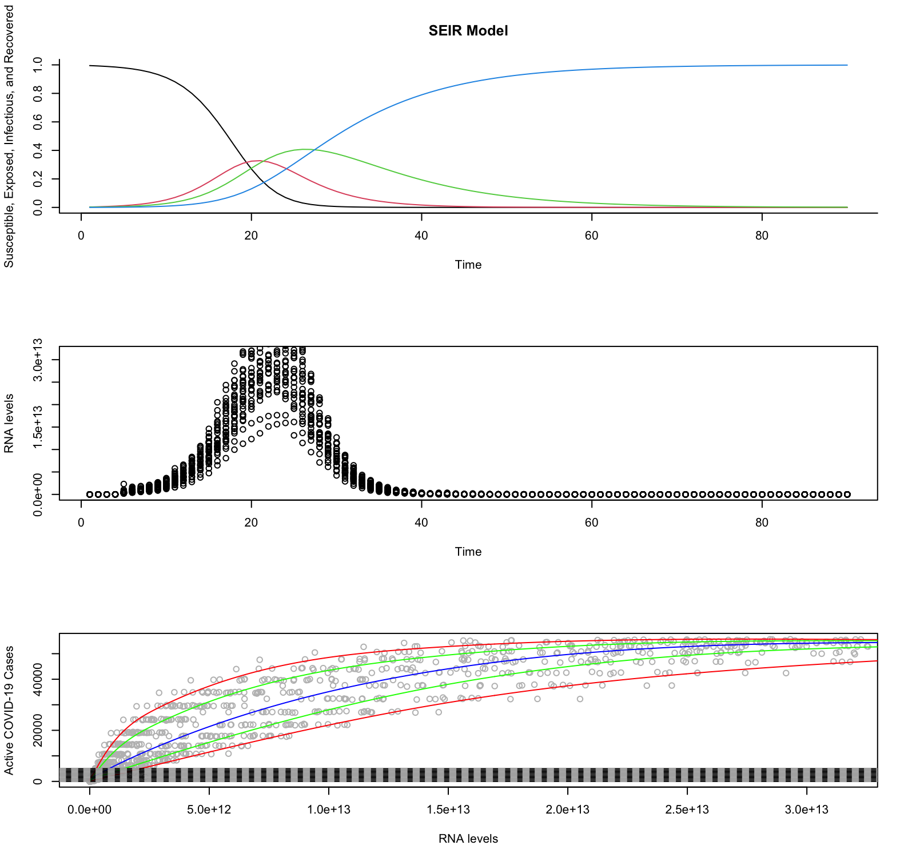

Slide 11
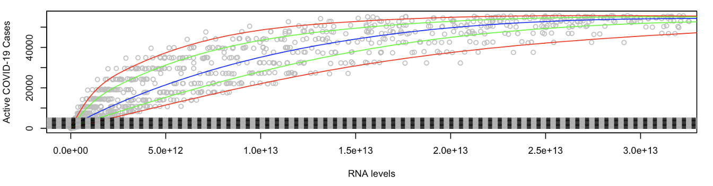
Extracted spline functions for median, 75% CI and 95% CI

Slide 12
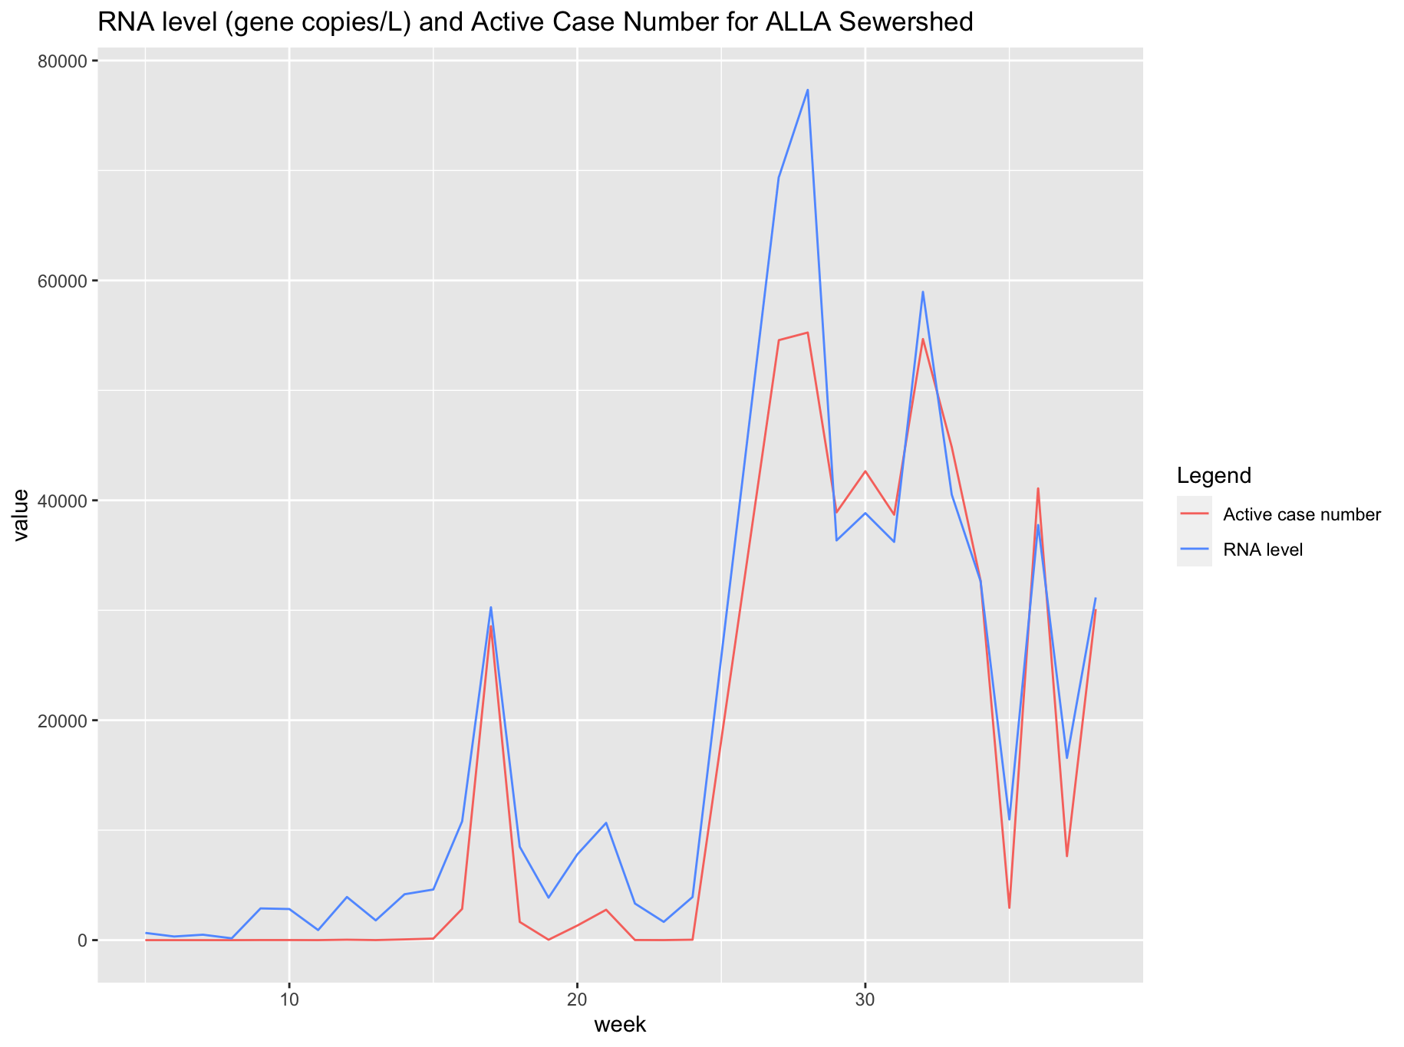
Max active case no:
~56,000

Slide 13
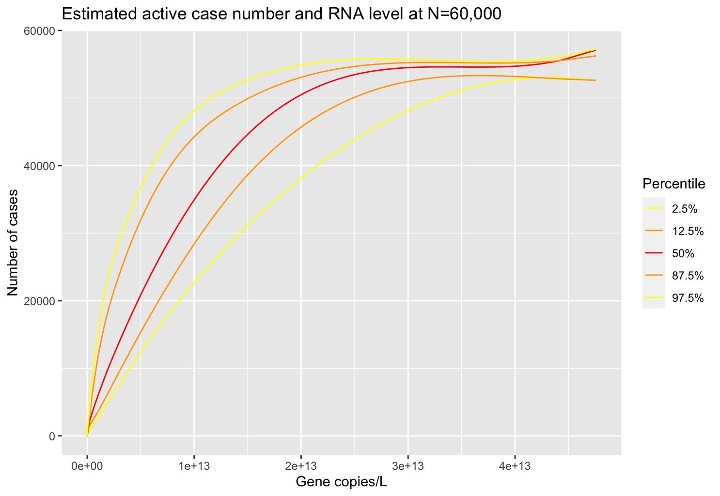

Slide 14
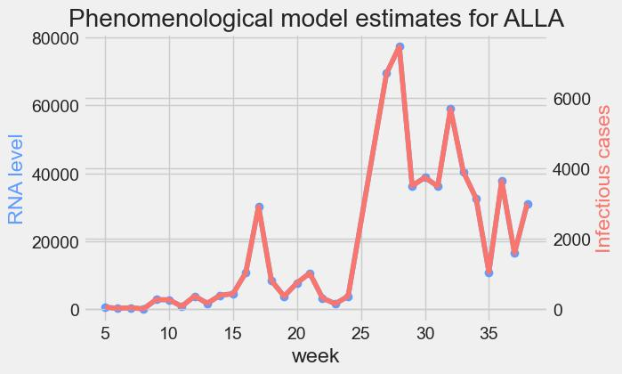
Comparison with phenomenological model (Prevalence)

Slide 15
Assumptions
Recovered individuals are no longer susceptible
Susceptibility is independent of individual characteristics (age, comorbidities, deprivation etc.)
Homogenous and well-mixed population (equal contact rate)
Population is large and constant

Slide 16
COVID19Wastewater package
Pros
Cons
Zero values of RNA level can be used in the model without transformation
Multiple variables are taken into account
Confidence interval available
Effect of adjusting parameters on the model is to be tested
Irregular estimated case numbers when RNA level is high → related to spline function?
Computation time depends on number of simulations

Slide 17
Regression e.g. linear mixed models
Pros
Cons
Regression is a widely used method with abundant references
Possible to see the effect of each input on the outcome (number of new cases)
Confidence interval available
Not real-time since it uses a range of past values
Likely to result in poor model accuracy as stated in the original paper

Slide 18
Machine learning
Pros
Cons
Gradient Boosting Trees Regressor yielded highest accuracy from original paper
xgboost package is computationally inexpensive
Black-box model: unable to explain mechanism of factors affecting incidence / Rt
Tuning of model can be complicated

Slide 19
Epyestim package
Original (R):
https://cran.r-project.org/web/packages/EpiEstim/
COVID-19 adaptation (Python):
https://github.com/lo-hfk/epyestim/blob/main/notebooks/covid_tutorial.ipynb
Distribution of generation time
Distribution of delays from infection to reporting
Does not apply to wastewater data
Estimation done in days

Slide 20
More Variables to consider for the model
Contact rate
COMIX
OxCGRT Stringency Index (national level only)
Lockdown period as cut-off
Vaccination
Population density
Seasonality (effect on temperature and RNA half-life)
Content of wastewater e.g. pH, suspended solids etc.
Correction factor for extremely high / low RNA levels
As shown in original paper with poorer fit to the phenomenological model for prevalence

Slide 21
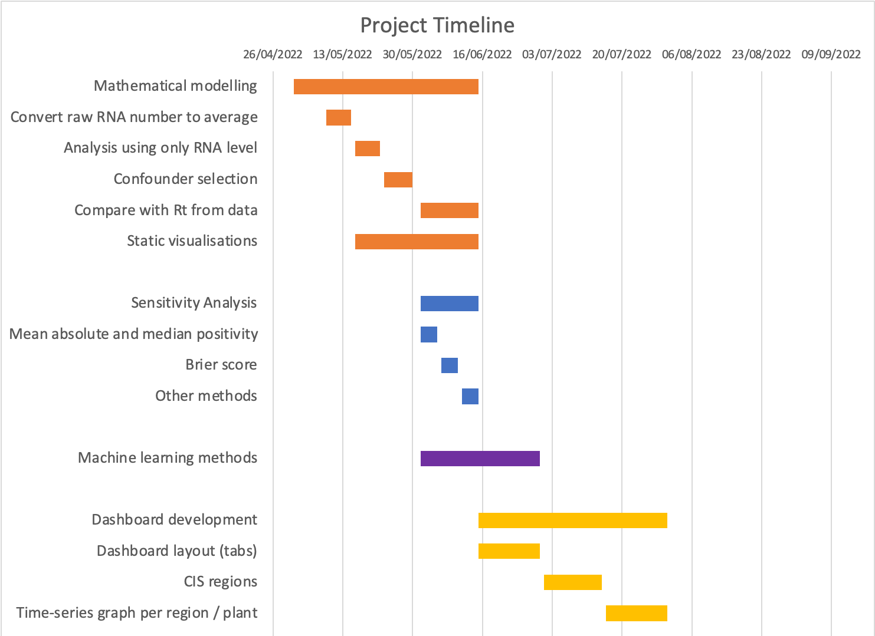

Slide 22
Next steps
Number of new cases
Model uncertainty
Granularity → 7 NHS regions and national
Sensitivity analysis
Mean absolute error (MAE)
Dashboard production
Maps
Line

